Slide 1
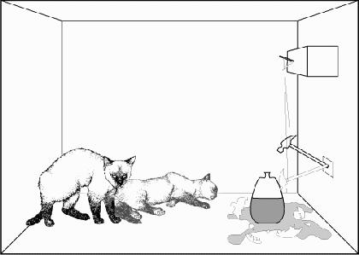
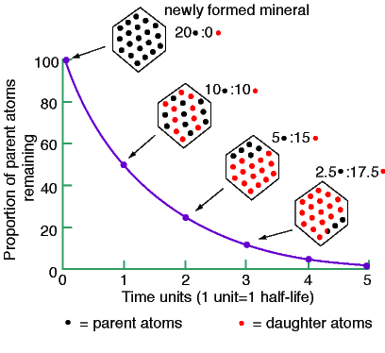

CHEM 702: Lecture 6
Radioactive Decay Kinetics
Part 2
Outline
Readings: Modern Nuclear Chemistry Chapter 3; Nuclear and Radiochemistry Chapters 4 and 5
Radioactive decay kinetics
  Basic decay equations
  Utilization of equations
    Mixtures
    Equilibrium
    Branching
  Natural radiation
  Dating

Slide 2
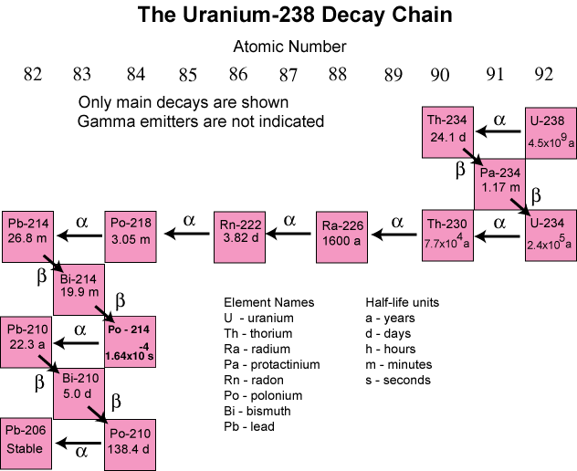
Parent – daughter decay
Isotope can decay into radioactive isotope
  Uranium and thorium decay series
    Alpha and beta
      A change from alpha decay
Different designation
  4n (²³²Th)
  4n+2 (²³⁸U)
  4n+3 (²³⁵U)
For a decay parent -> daughter
  Rate of daughter formation dependent upon parent decay rate- daughter decay rate

Slide 3
Parent - daughter
How does daughter isotope change with parent decay
  isotope 1 (parent) decays into isotope 2 (daughter)
Rearranging gives
Solve and substitute for N₁ using N_{1t}=N_{1o}e^{-λt}
  Linear 1st order differential equation
    Solve by integrating factors
Multiply by e^{λ2t}

Slide 4
Parent-daughter
Integrate over t
Multiply by e^{-λ}₂^{t} and solve for N₂
Initial daughter
Growth of daughter from parent

Slide 5
Parent daughter relationship
Find N, can solve equation for activity from A=λΝ
Find maximum daughter activity based on dN/dt=0
Solve for t
For ^{99m}Tc (t_{1/2}=6.01 h) from ⁹⁹Mo (2.75 d), find time for maximum daughter activity
  λ_{Tc}=2.8 d⁻¹, λ_{Mo}=0.25 d⁻¹

Slide 6
Half life relationships
Can simplify relative activities based on half life relationships
No daughter decay
  No activity from daughter
  Number of daughter atoms due to parent decay
Daughter Radioactive
No Equilibrium
  If parent is shorter-lived than daughter (λ₁>λ₂)
    no equilibrium attained at any time
  Daughter reaches maximum activity when λ₁N₁=λ₂N₂
    All parents decay, then decay is based on daughter

Slide 7
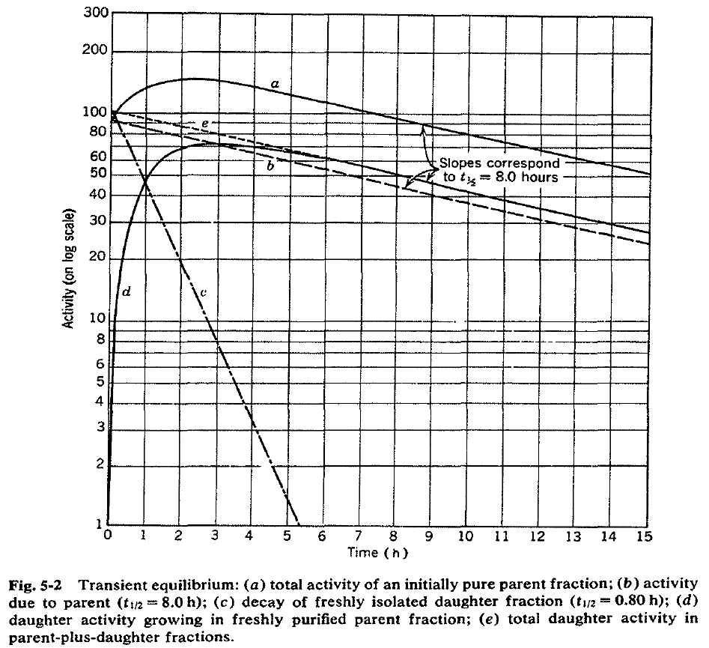
Half life relationships
Transient equilibrium
  Parent half life greater than 10 x daughter half life
    (λ₁ < λ₂)
Parent daughter ratio becomes constant over time
  As t goes toward infinity

Slide 8
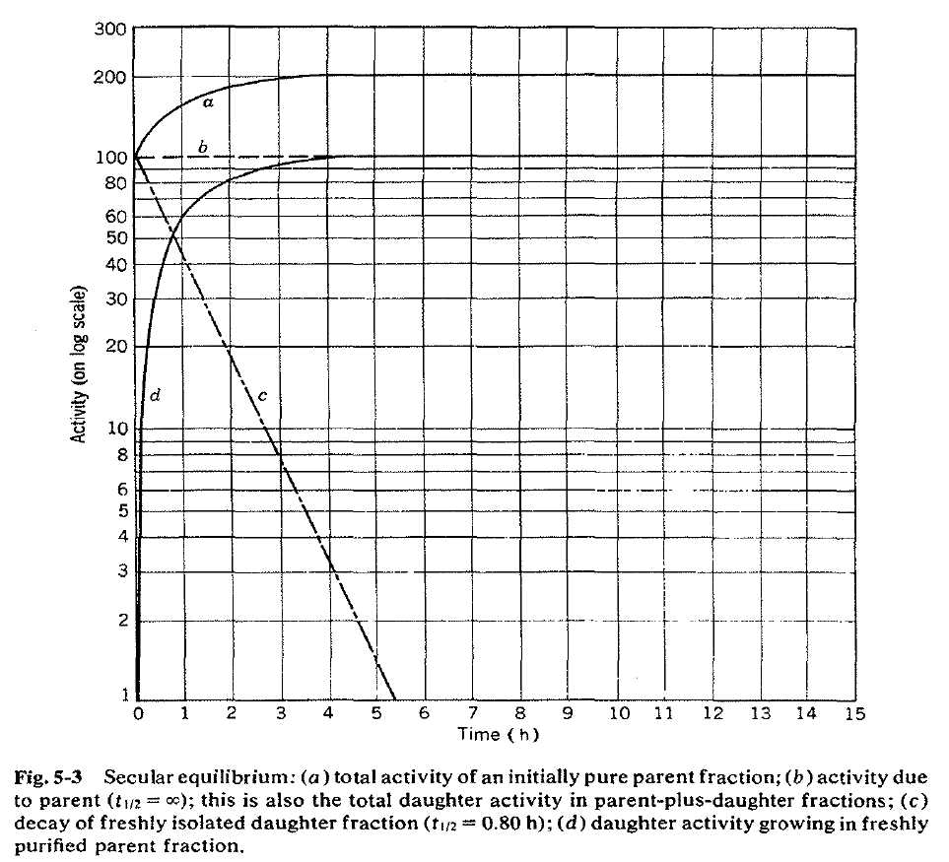
Half life relationship
Secular equilibrium
  Parent much longer half-life than daughter
    1E4 times greater
(λ₁ << λ₂)
  Parent activity does not measurably decrease in many daughter half-lives

Slide 9
Many Decays
Can use the Bateman solution to calculate entire chain
Bateman assumes only parent present at time 0
Program for Bateman http://www.ergoffice.com/downloads.aspx

Slide 10
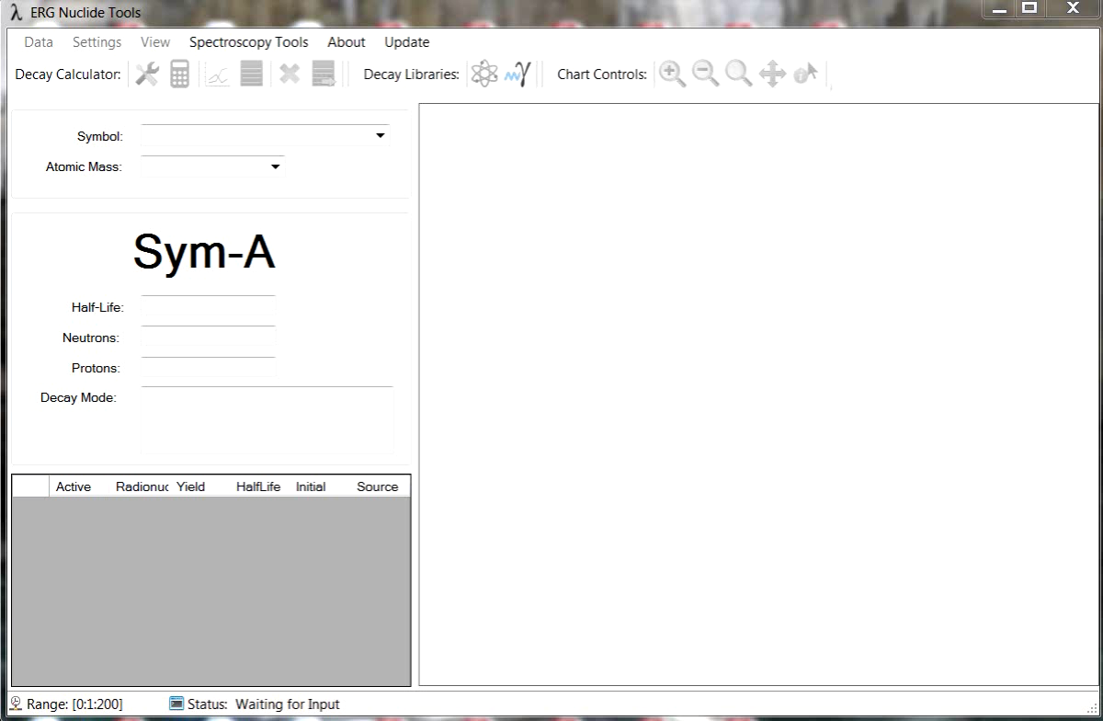
Review of ERG Program

Slide 11
Environmental radionuclides and dating
Primordial nuclides that have survived since time elements were formed
  t_{1/2}>1E9 a
  Decay products of these long lived nuclides
    ⁴⁰K, ⁸⁷Rb, ²³⁸U, ²³⁵U, ²³²Th
shorter lived nuclides formed continuously by interaction of comic rays with matter
  ³H, ¹⁴C, ⁷Be
    ¹⁴N(n, ¹H )¹⁴C (slow n)
    ¹⁴N(n, ³H )¹²C (fast n)
anthropogenic nuclides introduced into the environment by activities of man
  Actinides and fission products
  ¹⁴C and ³H

Slide 12
Dating
Radioactive decay as clock
  Based on N_{t}=N_{o}e^{-λt}
    Solve for t
N₀ and N_{t} are the number of radionuclides present at times t=0 and t=t
  N_{t} from A = λN
t the age of the object
  Need to determine N_{o}
    For decay of parent P to daughter D total number of nuclei is constant

Slide 13
Dating
P_{t}=P_{o}e^{-λt}
Measuring ratio of daughter to parent atoms
  No daughter atoms present at t=0
  All daughter due to parent decay
  No daughter lost during time t
A mineral has a ²⁰⁶Pb/²³⁸U =0.4. What is the age of the mineral?
    2.2E9 years

Slide 14
Dating
¹⁴C dating
  Based on constant formation of ¹⁴C
    No longer uptakes C upon organism death
227 Bq ¹⁴C /kgC at equilibrium
What is the age of a wooden sample with 0.15 Bq/g C?

Slide 15
Dating
Determine when Oklo reactor operated
  Today 0.7 % ²³⁵U
  Reactor 3.5 % ²³⁵U
  Compare ²³⁵U/²³⁸U (U_{r}) ratios and use N_{t}=N_{o}e^{-λt}

Slide 16
Topic review
Utilize and understand the basic decay equations
Relate half life to lifetime
Understand relationship between count time and error
Utilization of equations for mixtures, equilibrium and branching
Use cross sections for calculation nuclear reactions and isotope production
Utilize the dating equation for isotope pair

Slide 17
Study Questions
Compare and contrast nuclear decay kinetics and chemical kinetics.
If M is the total number of counts, what is the standard deviation and relative error from the counts?
Define Curie and Becquerel
How can half-life be evaluated?
What is the relationship between the decay constant, the half-life, and the average lifetime?
For an isotope the initial count rate was 890 Bq. After 180 minutes the count rate was found to be 750 Bq. What is the half-life of the isotope?
A 0.150 g sample of ²⁴⁸Cm has a alpha activity of 0.636 mCi. What is the half-life of ²⁴⁸Cm?
What is the half life for each decay mode for the isotope ²¹²Bi?
How are cross sections used to determine isotope production rate?
Determine the amount of ⁶⁰Co produced from the exposure of 1 g of Co metal to a neutron flux of 10¹⁴ n/cm²/sec for 300 seconds.
What are the basic assumptions in using radionuclides for dating?

Slide 18
Useful projects
Make excel sheets to calculate
  Mass or mole to activity
    Calculate specific activity
  Concentration and volume to activity
    Determine activity for counting
  Isotope production from irradiation
  Parent to progeny
    Daughter and granddaughter
      i.e., ²³⁹U to ²³⁹Np to ²³⁹Pu

Slide 19
Question
Comment on Blog
Respond to Lecture 6 PDF Quiz

